Slide 1
Secure Data Hiding in Images Using Steganography
CAPSTONE PROJECT
Presented By: Hanshu Agrahari
Student Name : Hanshu Agrahari
College Name :SRM Institute of Science and Technology
Department :computer science and engineering

Slide 2
OUTLINE
Problem Statement
Technology used
Wow factor
End users
Result
Conclusion
Git-hub Link
Future scope

Slide 3
Problem Statement
In an era of digital communication, protecting sensitive information is crucial. Traditional encryption methods can attract attention and may be vulnerable to attacks. Steganography conceals data within images, making changes imperceptible to the human eye. This project focuses on developing and implementing steganographic methods to enhance data security and confidentiality.

Slide 4
Technology used
Python Libraries
OpenCV:
Utilized for advanced image processing tasks, enabling efficient manipulation and analysis of images for steganography.
Programming Languages
Python:
Chosen for its simplicity and extensive libraries, making it an ideal choice for implementing steganographic techniques.
Platform for OpenCV (cv2)
Operating Systems:
Windows:
Supports the development and execution of OpenCV applications, providing a robust environment for image processing tasks.

Slide 5
Wow factors
Enhanced Security: Combines encryption with steganography for higher data protection.
Imperceptibility: Modifications to images are undetectable to the human eye.
Customizable Algorithms: Users can choose from various steganographic techniques.
Real-Time Processing: Enables immediate encoding and decoding of messages.
User-Friendly Interface: Intuitive GUI for easy operation without technical expertise.
Cross-Platform Compatibility: Works on Windows, Linux, and macOS.
Multiple Image Format Support: Handles JPEG, PNG, BMP, and more.
Data Integrity Checks: Ensures the hidden message remains unchanged during transmission.

Slide 6
End users
Individuals:
Users seeking to securely share personal messages or data without detection.
Businesses:
Companies looking to protect sensitive information during digital communication and ensure confidentiality.
Researchers:
Academics and professionals studying data security, cryptography, and digital forensics.
Software Developers:
Developers integrating steganography features into applications for enhanced data protection.
Content Creators:
Artists and multimedia creators wanting to embed hidden information in images or videos for copyright protection or branding.

Slide 7
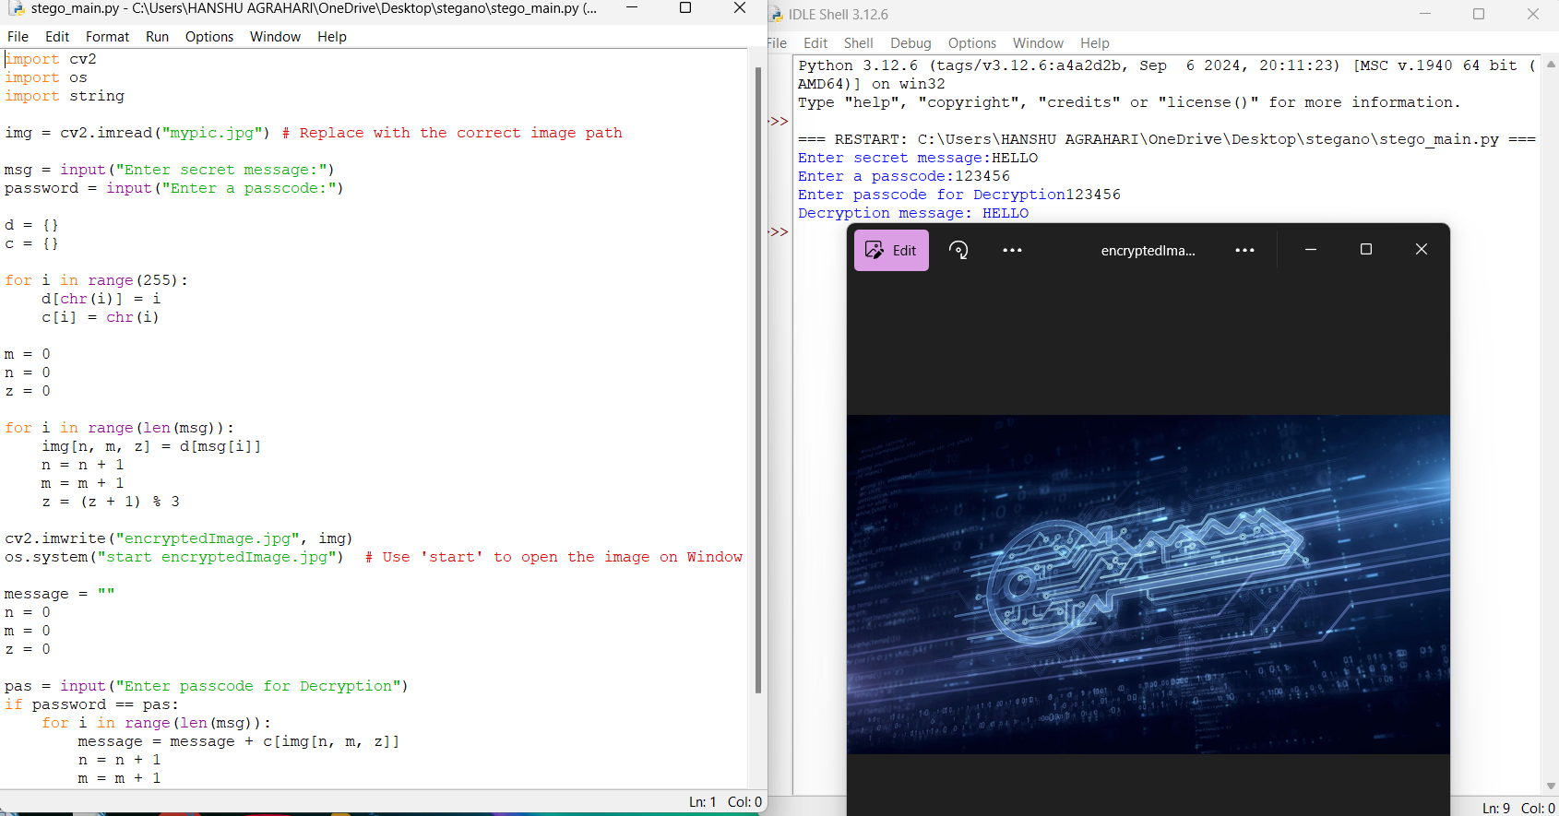
Results
Screenshots of the outcome (min 3)

Slide 8
Conclusion
In conclusion, the steganography project utilizing OpenCV and Python represents a significant advancement in secure communication technologies. By embedding hidden messages within images, it provides a dual layer of protection through both steganography and encryption, addressing the critical need for privacy in an interconnected world. Its unique features—enhanced security, imperceptibility, and user-friendly interfaces—make it accessible to a diverse audience, including individuals, businesses, and researchers, empowering them to take control of their data privacy.
Looking ahead, the potential for future enhancements, such as machine learning integration and mobile application development, ensures that the project can continuously adapt to meet emerging challenges. As digital threats evolve, this initiative will play a crucial role in promoting digital security and privacy. By fostering awareness and understanding of secure information sharing, the project not only safeguards sensitive data but also contributes to a safer digital landscape for everyone.

Slide 9
GitHub Link
GITHUB LINK:https://github.com/HanshuAgr/AICTE-PROJECT.git

Slide 10
Future scope(optional)
Looking ahead, the steganography project can be further enhanced by integrating additional features and exploring new technologies. Potential developments include:
Machine Learning Integration: Utilizing machine learning algorithms to improve the robustness and adaptability of steganographic techniques against detection.
Mobile Application Development: Creating mobile applications to enable users to encode and decode messages on-the-go, increasing accessibility and convenience.
Support for Video Steganography: Expanding capabilities to embed messages within video files, broadening the scope of applications beyond static images.
Real-Time Collaboration Features: Implementing collaborative tools that allow multiple users to securely share information in real-time.
Enhanced Encryption Methods: Incorporating advanced encryption techniques to further protect hidden messages from unauthorized access.

Slide 11
THANK YOU

